Slide 1
Communication and Protocols

Slide 2
Requirements
DNS
Email server
Message Parser
Network
IR transmitter
X-10
Insteon
Protocols
Wi-Fi
Bluetooth
Z-Wave
ZigBee

Slide 3
Arduino – Raspberry pi
Runs over Linux OS
Advantage
Not very possible for the software to break.
Disadvantage
Linux security is the most vulnerable since Linux provides access to every file in the device.

Slide 4
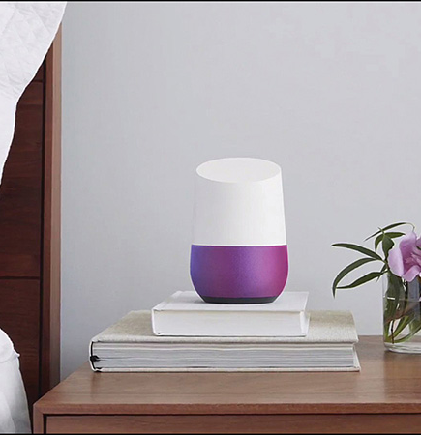
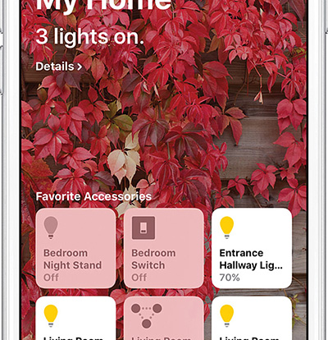

Smart home controllers

Slide 5
References
- Goodwin, S. (2013) Smart home automation with Linux and Raspberry Pi. (Technology in Action). Berkeley CA? Apress.
- Miller, M. (2017) My smart home for seniors. Indianapolis, Indiana: Que.

